Slide 1
Transportation Problem (TP) and Assignment Problem (AP)
(special cases of Linear Programming)

Slide 2
1. Transportation Problem (TP)
Distributing any commodity from any group of supply centers, called sources, to any group of receiving centers, called destinations, in such a way as to minimize the total distribution cost (shipping cost).

Slide 3
1. Transportation Problem (TP)
Total supply must equal total demand.
If total supply exceeds total demand, a dummy destination, whose demand equals the difference between the total supply and total demand is created. Similarly if total supply is less than total demand, a dummy source is created, whose supply
equals the difference.
All unit shipping costs into a dummy destination or out of a dummy source are 0.

Slide 4
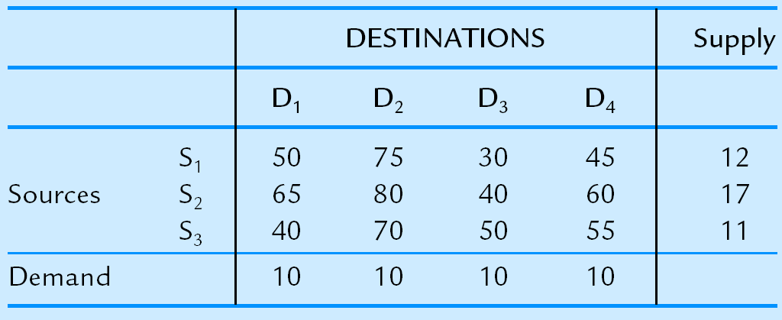
Example 1:

Slide 5
Example 2:
 |  | Destination |  |  | Supply
 | D1 | D2 | D3 | D4
S1 | 50 | 75 | 35 | 75 | 12
Source S2 | 65 | 80 | 60 | 65 | 17
S3 | 40 | 70 | 45 | 55 | 11
(D) | 0 | 0 | 0 | 0 | 10
Demand | 15 | 10 | 15 | 10

Slide 6
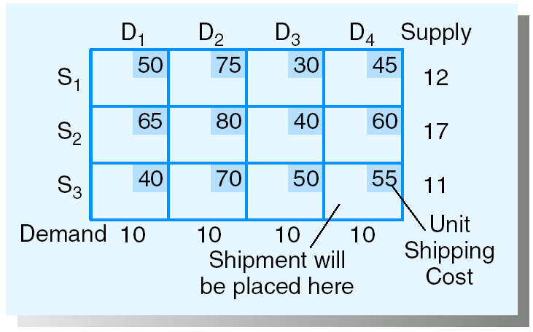
Transportation Tableau:

Slide 7
Initial Solution Procedure:
1. Northwest Corner Starting Procedure
1. Select the remaining variable in the upper left (northwest) corner and note the supply remaining in the row, s, and the demand remaining in the column, d.
2. Allocate the minimum of s or d to this variable. If this minimum is s, eliminate all variables in its row from future consideration and reduce the demand in its column by s; if the minimum is d, eliminate all variables in the column from future consideration and reduce the supply in its row by d.
REPEAT THESE STEPS UNTIL ALL SUPPLIES HAVE BEEN ALLOCATED.

Slide 8
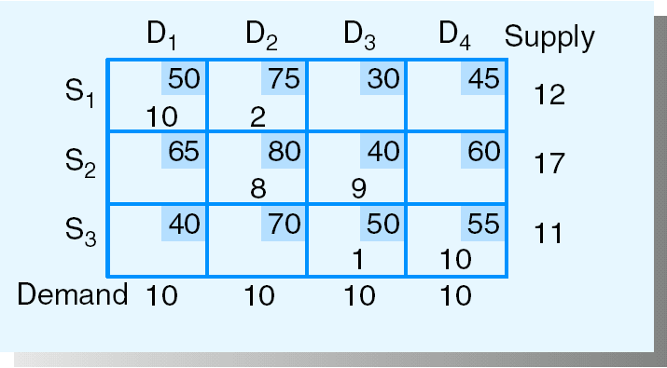
Total shipping cost = 2250

Slide 9
2. Least Cost Starting Procedure
1. For the remaining variable with the lowest unit cost, determine the remaining supply left in its row, s, and the remaining demand left in its column, d (break ties arbitrarily).
2. Allocate the minimum of s or d to this variable. If this minimum is s, eliminate all variables in its row from future consideration and reduce the demand in its column by s; if the minimum is d, eliminate all variables in the column from future consideration and reduce the supply in its row by d.
REPEAT THESE STEPS UNTIL ALL SUPPLIES HAVE BEEN ALLOCATED.

Slide 10
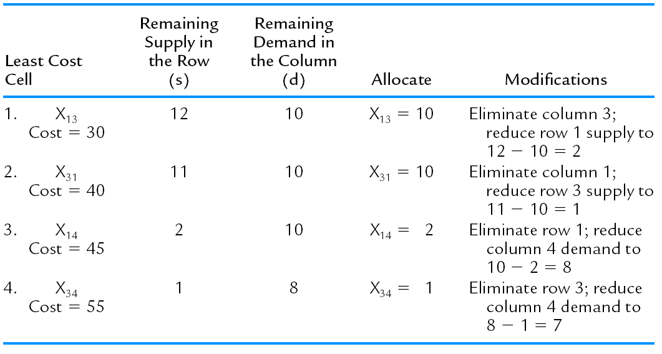

Slide 11
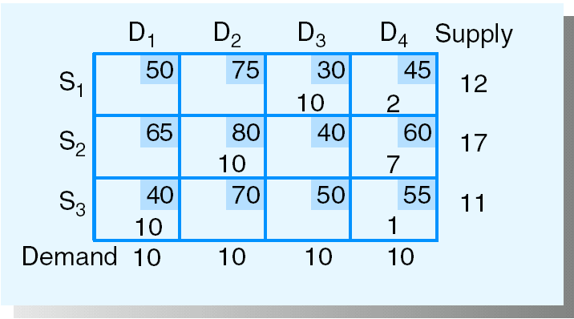
Total shipping cost = 2065

Slide 12
3. Vogel’s Approximation Method Starting Procedure
1. For each remaining row and column, determine the difference between the lowest two remaining costs; these are called the row and column penalties.
2. Select the row or column with the largest penalty found in step 1 and note the supply remaining for its row, s, and the demand remaining in its column, d.
3. Allocate the minimum of s or d to the variable in the selected row or column with the lowest remaining unit cost. If this minimum is s, eliminate all variables in its row from future consideration and reduce the demand in its column by s; if the minimum is d, eliminate all variables in the column from future consideration and reduce the supply in its row by d.
REPEAT THESE STEPS UNTIL ALL SUPPLIES HAVE BEEN ALLOCATED.

Slide 13
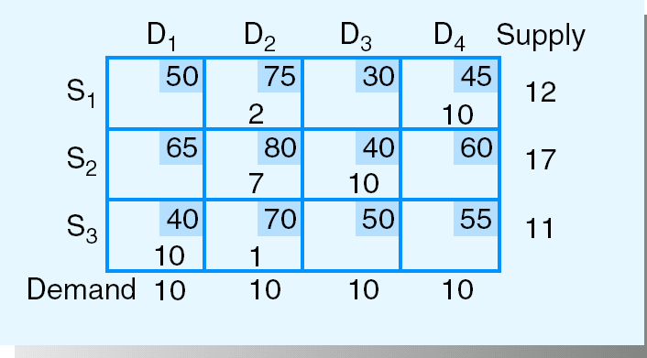
Total shipping cost = 2030

Slide 14
Solving TP – Transportation Simplex Method
1. Find the current C_{ij}–Z_{ij} values for each nonbasic variable and select the one with the most negative C_{ij}–Z_{ij} value as the entering variable; if all C_{ij}–Z_{ij} values are nonnegative, the current solution is optimal.
2. Determine which basic variable reaches 0 first when the entering variable is increased.
3. Determine a new basic solution and repeat the steps.

Slide 15
Step 1: Determine the C_{ij}–Z_{ij} Values for the Nonbasic Variables
1. If U_{i} is the dual variable associated with the i-th supply constraint, and V_{j} is the dual variable associated with the j-th demand constraint, then for shipments from node i to node j, one can find the corresponding Z_{ij} value by Z_{ij} = U_{i} - V_{j}. Thus the C_{ij}–Z_{ij} value for variable X_{ij} is found by
C_{ij} - Z_{ij} = C_{ij} - (U_{i} - V_{j}) = C_{ij} - U_{i} + V_{j}

Slide 16
2. Given that there is a redundant equation among the m n constraints (and any of the m n constraints can be considered the redundant one), one can show that the U_{i} or V_{j} associated with the redundant equation is 0. Thus one U_{i} or V_{j} can arbitrarily be selected and set to 0. Arbitrarily choose U₁ = 0.
3. Since the C_{ij}–Z_{ij} values for basic variables are 0 (i.e., C_{ij} - U_{i} + V_{j} = 0 for basic variables), we can easily solve for the remaining values of the U_{i}’s and V_{j}’s from the m + n - 1 equations for the basic variables.

Slide 17
4. Once the U_{i}’s and V_{j}’s have been determined, the C_{ij}–Z_{ij} values for the nonbasic variables can be calculated by
C_{ij} - Z_{ij} = C_{ij} - U_{i} + V_{j}

Slide 18
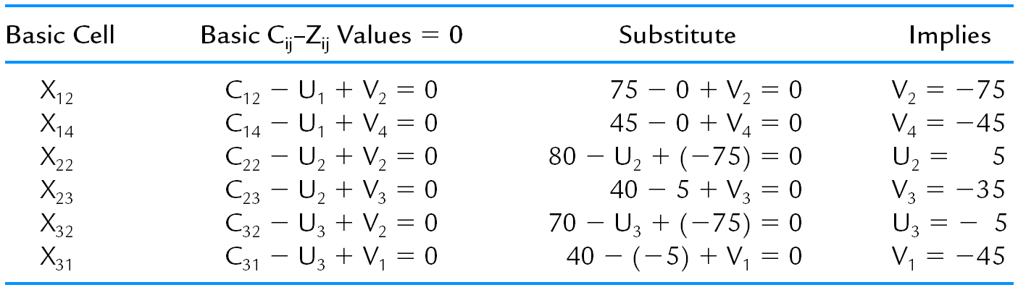

Slide 19
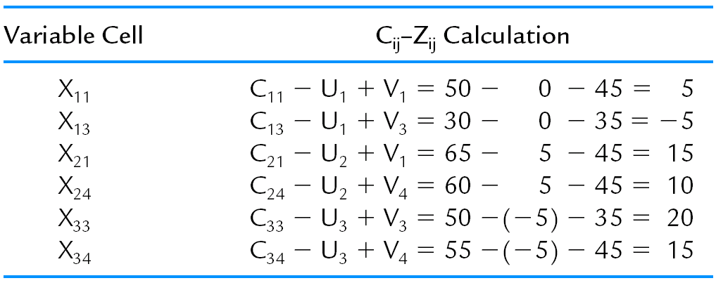
Non-basic cells:
Note: X₁₃ is the entering variable.

Slide 20
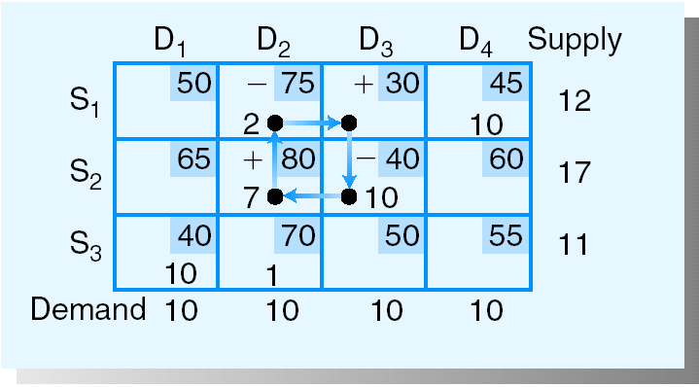
Step 2: Determine Which Current Basic Variable Reaches 0 First
Note: 1. Cycle property
2. X₁₂ is the leaving variable

Slide 21
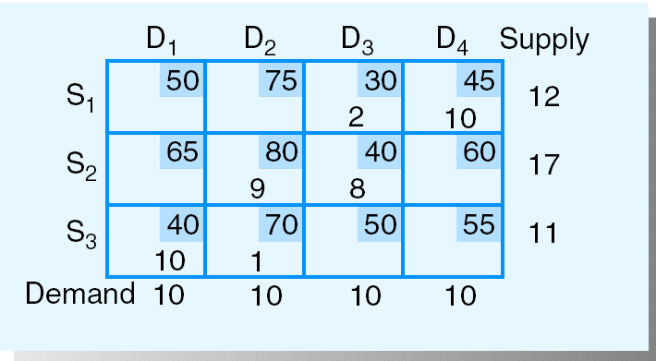
Step 3: Determine the Next Transportation Tableau
Total shipping cost = 2020
{Improvement = 2 (-5) = 10 }

Slide 22
Transportation Simplex Method
Find an initial basic feasible solution by some starting procedure. Then,
1. Set U₁ 0. Solve for the other U_{i}’s and V_{j}’s by:
C_{ij} – U_{i} + V_{j} = 0 for basic variables.
Then calculate the C_{ij}–Z_{ij} values for nonbasic variables by:
C_{ij} – Z_{ij} = C_{ij} – U_{i} + V_{j}
Choose the nonbasic variable with the most negative C_{ij}–Z_{ij} value as the entering variable. If all C_{ij}–Z_{ij} values are nonnegative, STOP; the current solution is optimal.
2. Find the cycle that includes the entering variable and some of the BASIC variables. Alternating positive and negative changes on the cycle, determine the “change amount” as the smallest allocation on the cycle at which a subtraction will be made.
3. Modify the allocations to the variables of the cycle found in step 2 by the “change amount” and return to step 1.

Slide 23
Note: there must be m + n - 1 basic variables for the transportation simplex method to work!
=> Add dummy source or dummy destination, if necessary
(m=# of sources and n=# of destinations)

Slide 24
2. The Assignment Problem (AP) —
a special case of TP with m=n and s_{i}=d_{j} for all i, and j.
The Hungarian Algorithm
=> solving the assignment problem of a least
cost assignment of m workers to m jobs

Slide 25
Assumptions:
1. There is a cost assignment matrix for the m “people” to be assigned to m “tasks.” (If necessary dummy rows or columns consisting of all 0’s are added so that the numbers of people and tasks are the same.)
2. All costs are nonnegative.
3. The problem is a minimization problem.

Slide 26
The Hungarian Algorithm
Initialization
1. For each row, subtract the minimum number from all numbers in that row.
2. In the resulting matrix, subtract the minimum number in each column from all numbers in the column.

Slide 27
Iterative Steps
1. Make as many 0 cost assignments as possible. If all workers are assigned, STOP; this is the minimum cost assignment. Otherwise draw the minimum number of horizontal and vertical lines necessary to cover all 0’s in the matrix. (A method for making the maximum number of 0 cost assignments and drawing the minimum number of lines to cover all 0’s follows.)
2. Find the smallest value not covered by the lines; this number is the reduction value.
3. Subtract the reduction value from all numbers not covered by any lines. Add the reduction value to any number covered by both a horizontal and vertical line.
GO TO STEP 1.

Slide 28
For small problems, one can usually determine the maximum number of zero cost assignments by observation. For larger problems, the following procedure can be used:
Determining the Maximum Number of Zero-Cost Assignments
1. For each row, if only one 0 remains in the row, make that assignment and eliminate the row and column from consideration in the steps below.
2. For each column, if only one 0 remains, make that assignment and eliminate that row and column from consideration.
3. Repeat steps 1 and 2 until no more assignments can be made. (If 0’s remain, this means that there are at least two 0’s in each remaining row and column. Make an arbitrary assignment to one of these 0’s and repeat steps 1 and 2.)

Slide 29
Again, for small problems, the minimum number of lines required to cover all the 0’s can usually be determined by observation. The following procedure, based on network flow arguments, can be used for larger problems:
Drawing the Minimum Number of Lines to Cover All 0’s
1. Mark all rows with no assignments (with a “‧”).
2. For each row just marked, mark each column that has a 0 in that row (with a “‧”).
3. For each column just marked, mark each row that has an assignment in that column (with a “‧”).
4. Repeat steps 2 and 3 until no more marks can be made.
5. Draw lines through unmarked rows and marked columns.

Slide 30
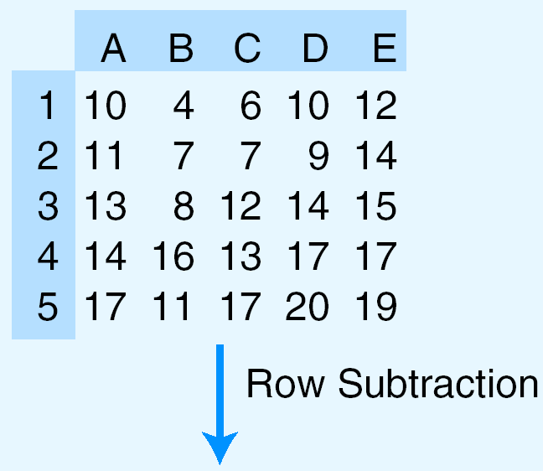
Example:

Slide 31
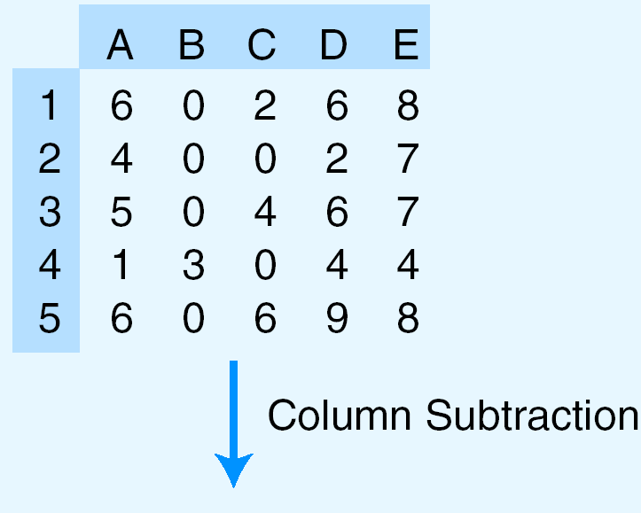

Slide 32
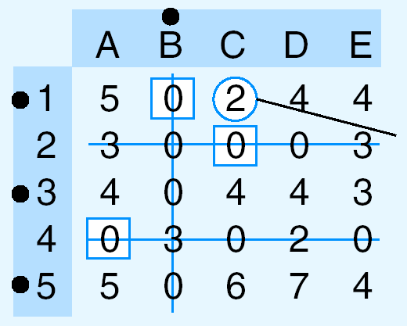
Minimum uncovered
number

Slide 33
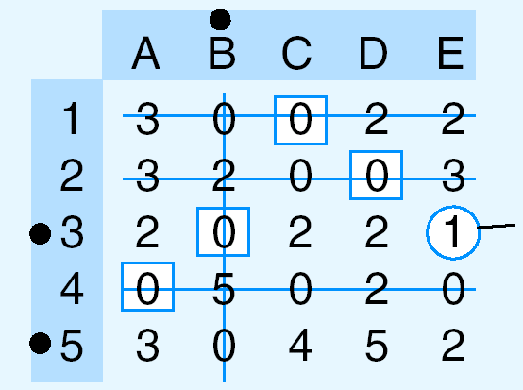
Minimum uncovered
number

Slide 34
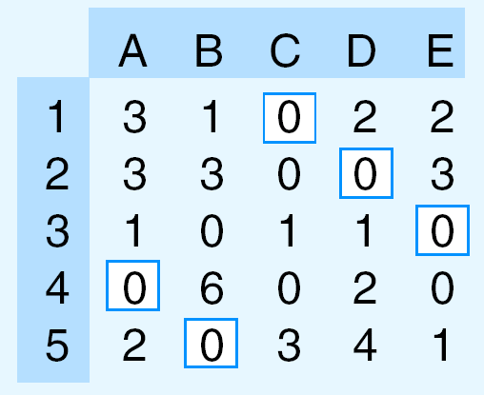
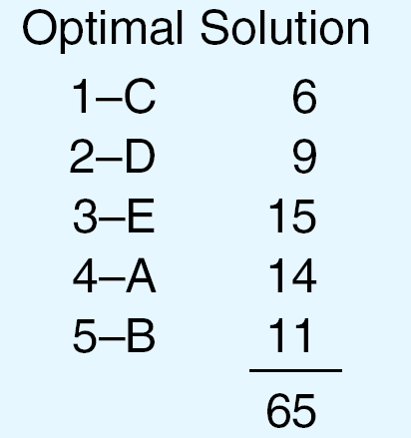

Slide 35
CONVERSION OF A MAXIMIZATION PROBLEM TO A MINIMIZATION PROBLEM
The Hungarian algorithm works only if the matrix is a cost matrix. A maximization assignment problem can be converted to a minimization problem by creating a lost opportunity matrix. The problem then is to minimize the total lost opportunity.

Slide 36
Profit Matrix:
J1 J2 J3 J4
W1 67 58 90 55
W2 58 88 89 56
W3 74 99 80 22
(D) 0 0 0 0

Slide 37
The lost opportunity matrix given below is derived by subtracting each number in the J1 column from 74, each number in the J2 column from 99, each number in the J3 column from 90, and each number in the J4 from 56.
J1 J2 J3 J4
W1 7 41 0 1
W2 16 11 1 0
W3 0 0 10 34
(D) 74 99 90 56
The Hungarian algorithm can now be applied to this lost opportunity matrix to determine the maximum profit set of assignments.

